Slide 1
Secure Data Hiding in Image Using Steganography
CAPSTONE PROJECT
Presented By: Chakravorty Devopriya Devashish
Student Name : Chakravorty Devopriya Devashish
College Name & Department : IIT Jammu & Post Graduate Diploma in Cybersecurity

Slide 2
OUTLINE
Problem Statement
Technology used
Wow factor
End users
Result
Conclusion
Git-hub Link
Future scope

Slide 3
Problem Statement
In the digital era, data security is of paramount importance, especially when transmitting sensitive information. Traditional encryption methods may not always be sufficient to protect data in transit, especially when dealing with large volumes of data. Moreover, many encryption methods are easily identifiable by attackers, which can lead to potential breaches in security.
This project addresses this issue by combining steganography (hiding data in plain sight) and encryption to create a more secure method of data transmission. By embedding a secret message inside an image and securing the passcode using encryption, we can create a robust system that offers enhanced security and data privacy.
The main goals of the project are:
Steganography-based Data Hiding: Securely hide a secret message inside an image, making it invisible to the human eye while maintaining the integrity of the original image.
Encryption of Passcode: Use encryption to protect the passcode used for message verification, ensuring that unauthorized users cannot easily access the hidden information.
Decryption and Authentication: Validate the encrypted passcode to ensure only authorized users can retrieve the hidden message from the image, ensuring the authenticity of the process.

Slide 4
Technology used
Python: The primary programming language used for this project.
Libraries:
opencv-python: Used for image processing and manipulation. It helps in reading, writing, and editing images for hiding and extracting data.
pycryptodome: Used for encryption and decryption of the passcode.
Streamlit : For GUI
Platforms:
GitHub: Used for version control and hosting the source code.
Python 3.x: The version of Python used to run the code and libraries.
Tools:
OpenCV: Image processing library for loading and modifying the pixel data in images.
IDE/Editor: Any Python-compatible IDE (e.g., Visual Studio Code, PyCharm) for writing and editing the source code.
Command Line Interface (CLI): Used for running the project using streamlit run command to start the app.
Operating System: The project is compatible with Windows, macOS, and Linux operating systems.

Slide 5
Wow factors
Combination of Encryption and Steganography:
Unlike many traditional steganography-based projects that focus only on hiding data within images, this project combines encryption of the passcode with image-based steganography. This ensures that even if someone gains access to the image, they cannot easily retrieve the message without the correct passcode, which is securely encrypted.
Secure Passcode Authentication:
The use of an encrypted passcode adds an extra layer of security to the system. The passcode is encrypted using public key cryptography and is required for both the encryption and decryption process, ensuring that unauthorized users cannot simply extract the hidden message.
Dynamic Length Adjustment:
The system dynamically adjusts for message length by ensuring that the length of the hidden message is encoded and decoded correctly. The decryption process verifies that the exact message length is met, preventing partial data from being exposed.
Multiple Steps of Security:
Passcode encryption before hiding the message.
GCD-based encoding pattern that adds another layer of security by making the message harder to detect by unauthorized users.
Verification of the passcode during decryption to ensure that only authorized users can access the hidden message.
Visual Feedback:
The program provides visual feedback during the encryption and decryption process, showing progress and success messages, such as when the image with the encoded message is saved, which enhances the user experience.

Slide 6
End users
The end users of this project can vary depending on their needs for data security, privacy, and secure communication. Below are the key groups of end users who would benefit from this system:
Individuals Concerned with Privacy: People who are looking to securely send sensitive information, such as personal messages, confidential notes, or passwords, without exposing it to unauthorized access. By using this system, they can hide their message inside an image, making it less detectable to prying eyes.
Cybersecurity Enthusiasts: Those who are interested in exploring and learning about steganography, encryption, and data protection techniques. This project provides a hands-on example of how these concepts work together to secure information.
Privacy-Conscious Communicators: Users who need to communicate securely in environments where privacy is a concern (e.g., whistleblowers, journalists, activists). The encrypted passcode and hidden messages offer a secure way to communicate without revealing the content to eavesdroppers.
Researchers and Developers in Cryptography and Steganography: Cryptographers or researchers working on data protection techniques who might find this project useful as a proof-of-concept or as a base for more advanced cryptographic and steganographic algorithms.
Companies in Need of Data Protection: Organizations that want to send secure internal communications or sensitive business information over email or shared platforms, where the risk of interception exists. The use of steganography can help conceal confidential data in a way that's harder to detect by attackers.
Forensic Investigators: Professionals working in cybersecurity and digital forensics may find this system useful for extracting hidden data in case of a digital investigation. This project demonstrates how information can be concealed within images, which could be helpful when analyzing suspect devices or communications.
Educational Institutions: Students and educators in the field of computer science, cybersecurity, or digital forensics can use this project as an educational tool to learn about encryption, cryptography, and steganography techniques.

Slide 7
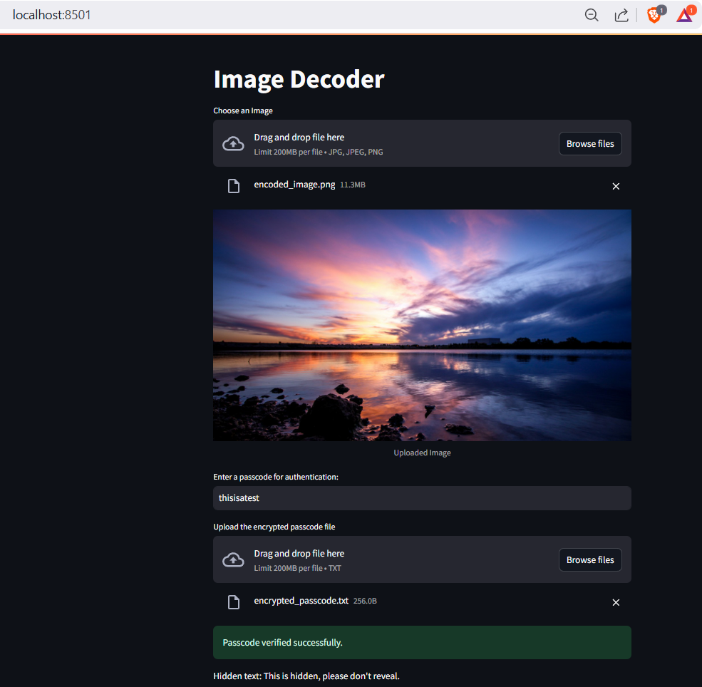
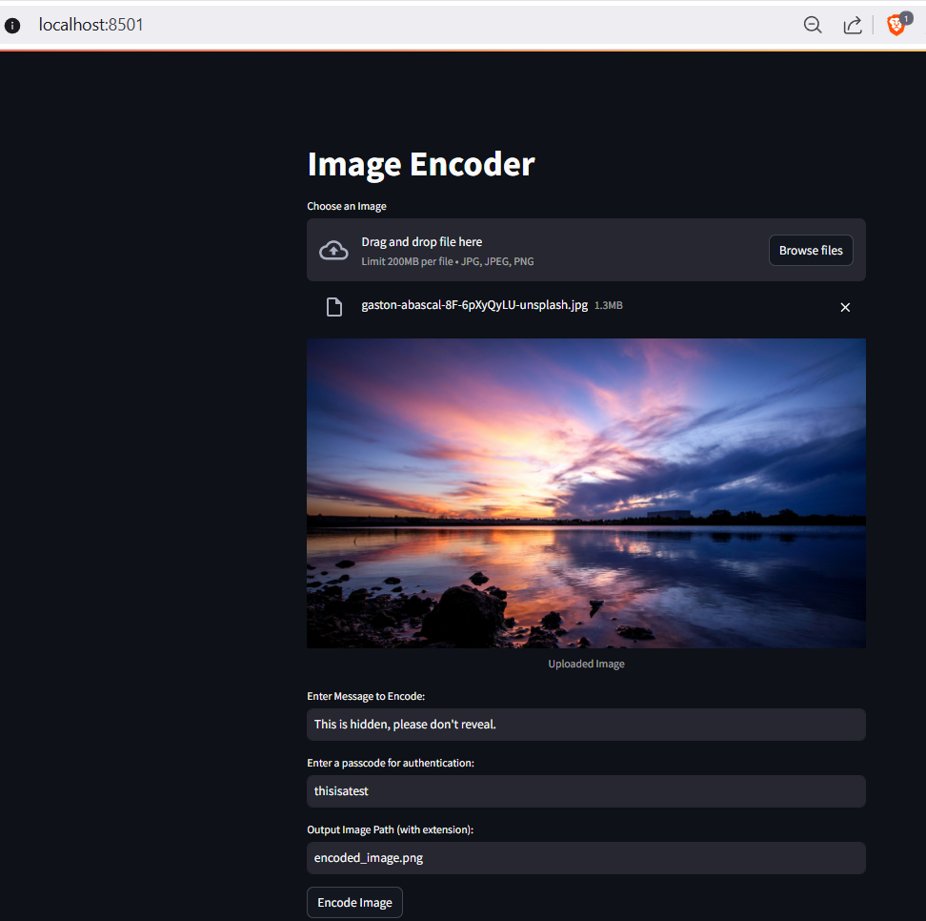
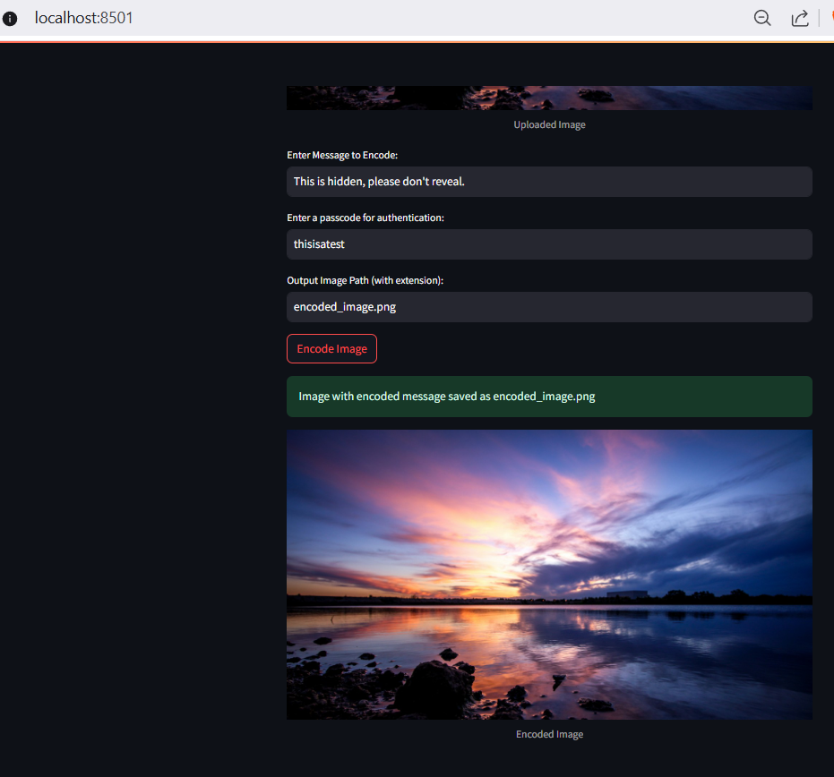
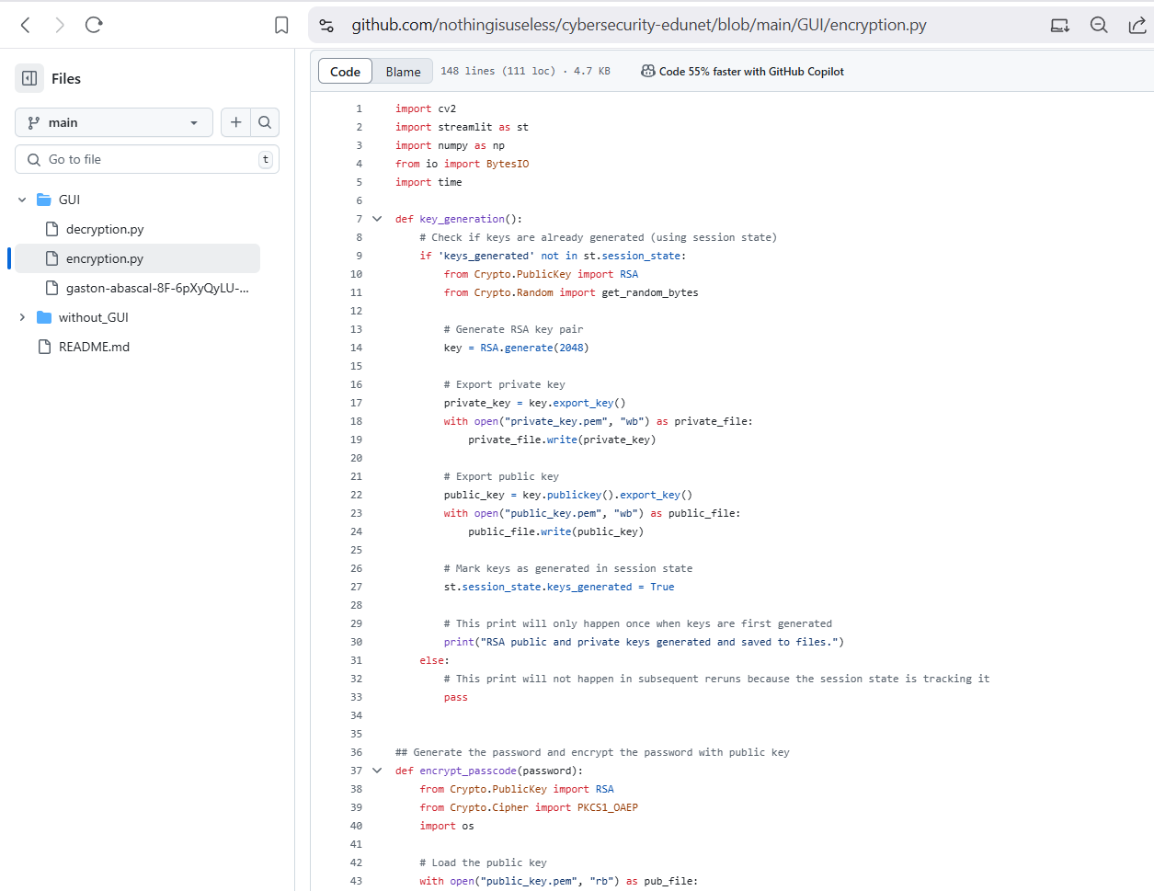
Results

Slide 8
Conclusion
This project, "Secure Data Hiding in Image Using Steganography", effectively addresses the problem of secure data transmission by combining the powerful techniques of encryption and steganography. In today’s digital world, the need for secure communication channels is more critical than ever, especially when dealing with sensitive information that must remain private. This system ensures that the data is not only hidden within an image but also protected through encryption, making it far more secure than traditional steganography approaches.
The solution presented in this project consists of two major components:
Encryption of the Passcode: Before hiding the secret message, the passcode used for authentication is encrypted, adding an extra layer of security to ensure that only authorized users can decrypt and access the hidden message. This approach prevents attackers from easily accessing the message, even if they gain access to the image.
Image-based Data Hiding: The secret message is concealed within the pixel data of an image using a custom pattern based on the GCD of the image dimensions, making the process highly secure and difficult to detect. This approach ensures that the integrity of the image is preserved, and the hidden message is invisible to the human eye.
The combination of these techniques ensures that the project solves the problem of transmitting sensitive information in a secure, covert, and reliable manner. Whether it’s for individuals concerned with privacy, researchers in cryptography, or businesses needing secure communication channels, the project provides an effective, easily implementable solution to enhance data security.
In conclusion, this project successfully meets the problem statement by providing an innovative way to securely hide data inside an image, with encryption ensuring that only authorized users can access the hidden message. The use of encryption and steganography in tandem provides a robust solution to the growing need for privacy and security in digital communications.

Slide 9
GitHub Link
https://github.com/nothingisuseless/cybersecurity-edunet.git

Slide 10
Future scope
Creating a windows/android application based out of this.
Currently the output file generated is a png file. Aim is to add more options for the output file.
To add more robust encoding logic for hiding text
To find an easy method to exchange the encryption keys

Slide 11
THANK YOU

